Slide 1
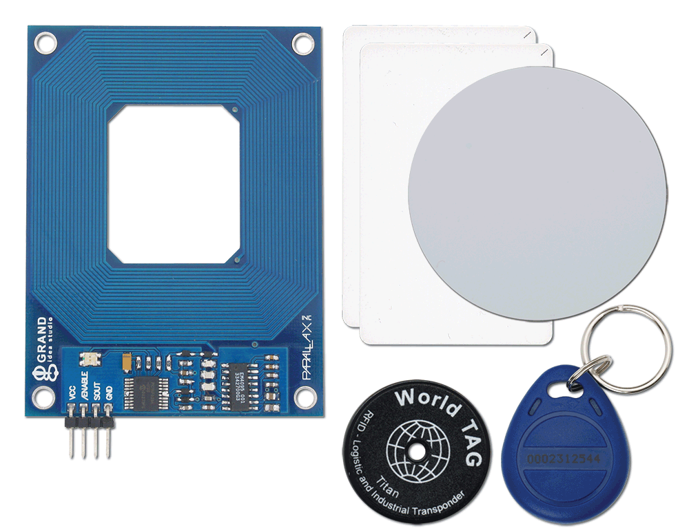

RFID Rader By: GurU Sharma

Slide 2
Introduction
RFID(Radio-frequency Identification) is an electronics device which has two parts - one is RFID Reader and other is RFID tag or Card.
When we put RFID tag near to the RFID reader, it reads tag data serially.
For this project, RFID reader is used to allow fast authentication for the users

Slide 3
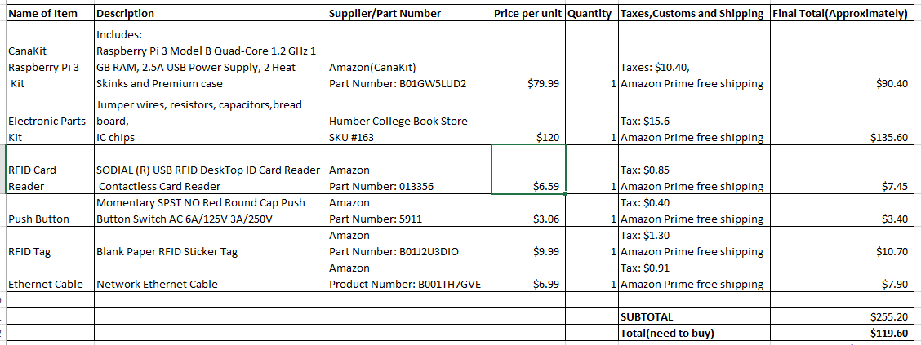
budget

Slide 4
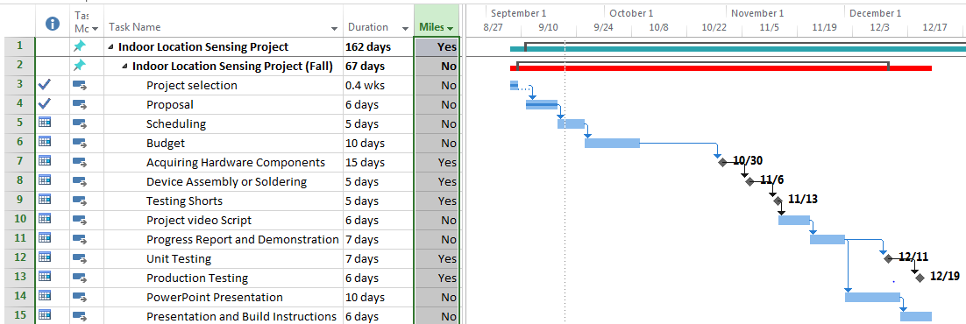
Schedule

Slide 5
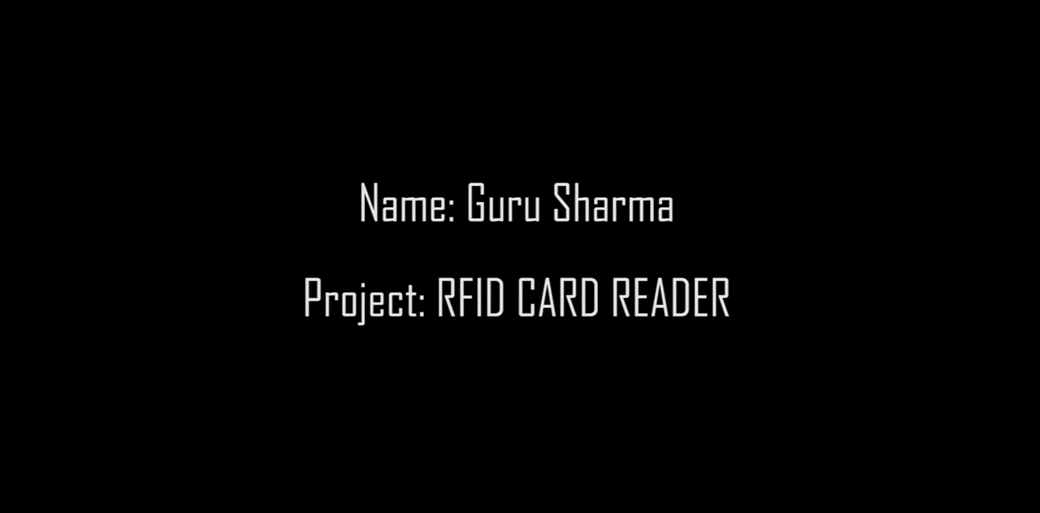
Build video

Slide 6
Course knowledge Utilized
TECH 101 – Electric Circuits & TECH 150 – Electronic Devices and Circuits In these courses we learned how to create voltage divider circuits and how to get readings from them.
TECH 153 – Technical C - In this course we worked on Raspberry PI and learned how to use GPIO pins
CENG 216 – Intro to Software Engineering In this course we learned about making budgets and learned how to create GANTT charts.

Slide 7
Thank you ☺

